Slide 1
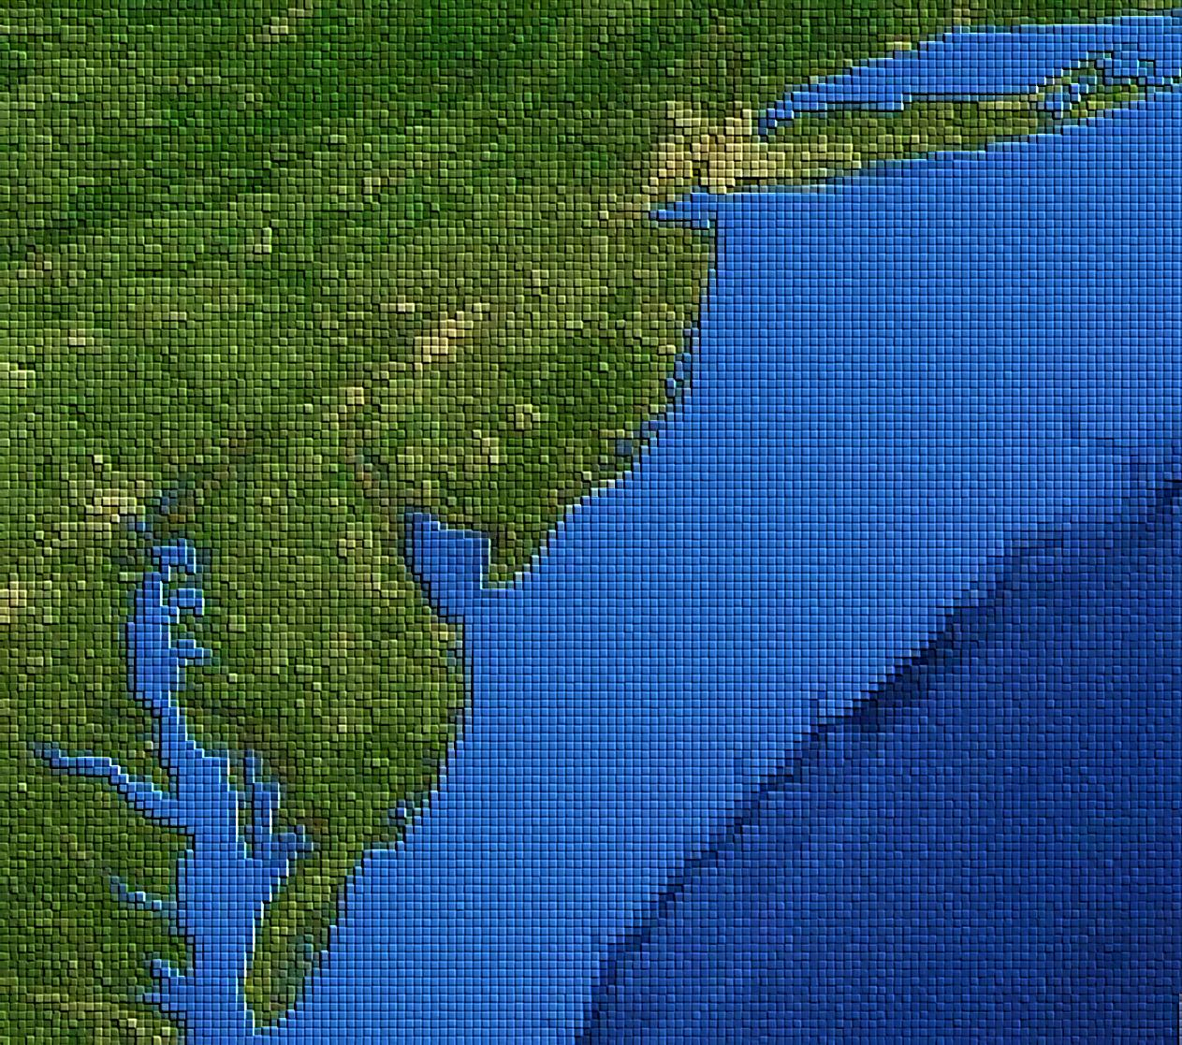
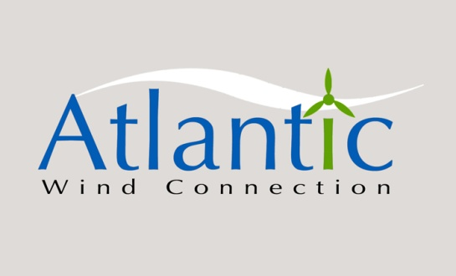
Building an Offshore Wind Industry
with the Atlantic Wind Connection
December 9, 2011
Robert Mitchell, CEO
Atlantic Wind Connection
202-258-0960
RMitchell@AtlanticWindConnection.com

Slide 2
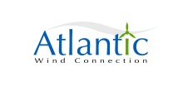
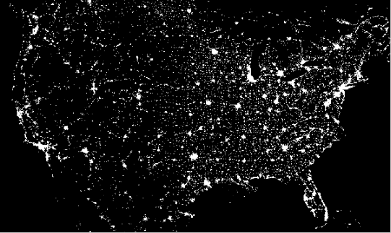
U.S. energy demand

Slide 3
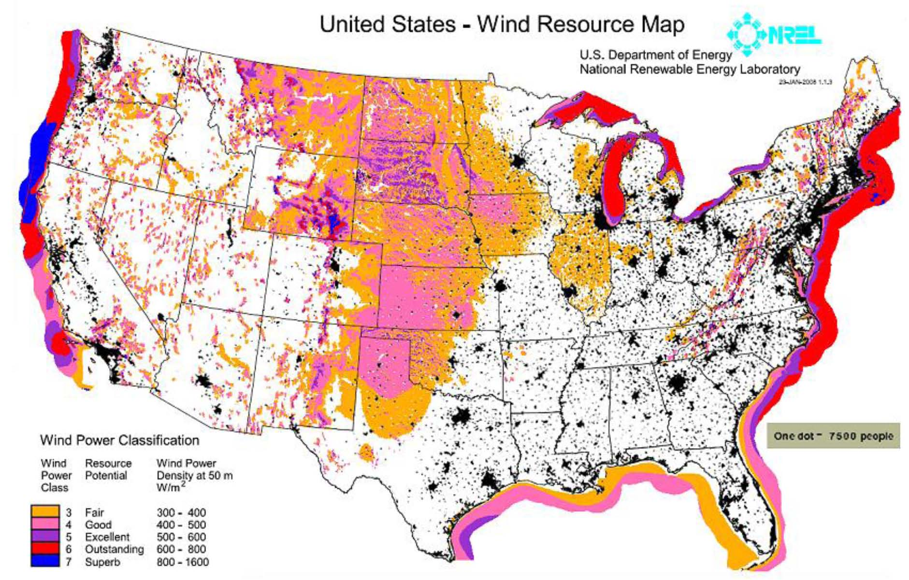
“The mid-Atlantic region offers the most abundant and most attractive offshore wind resources in the country.” The Brattle Group
3

Slide 4
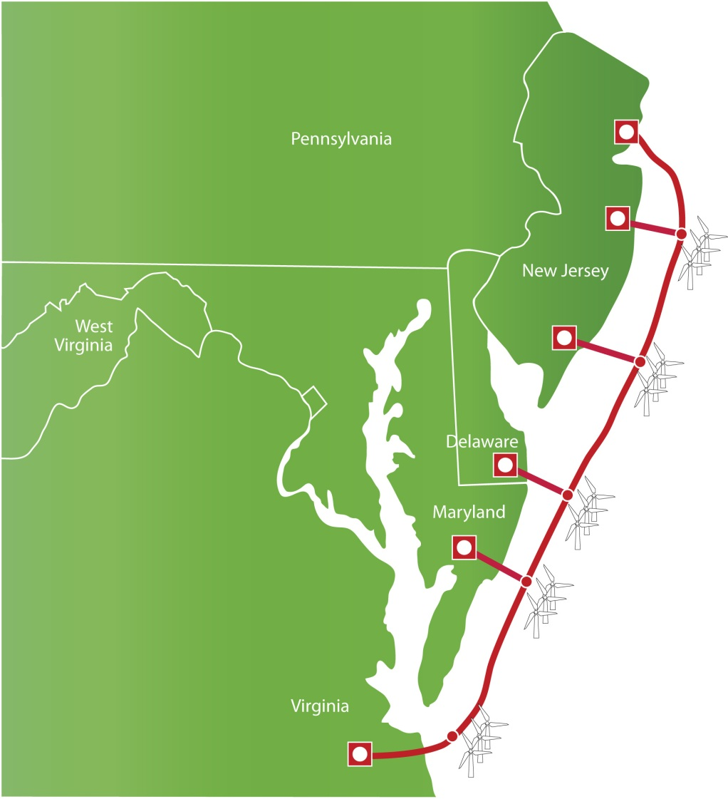
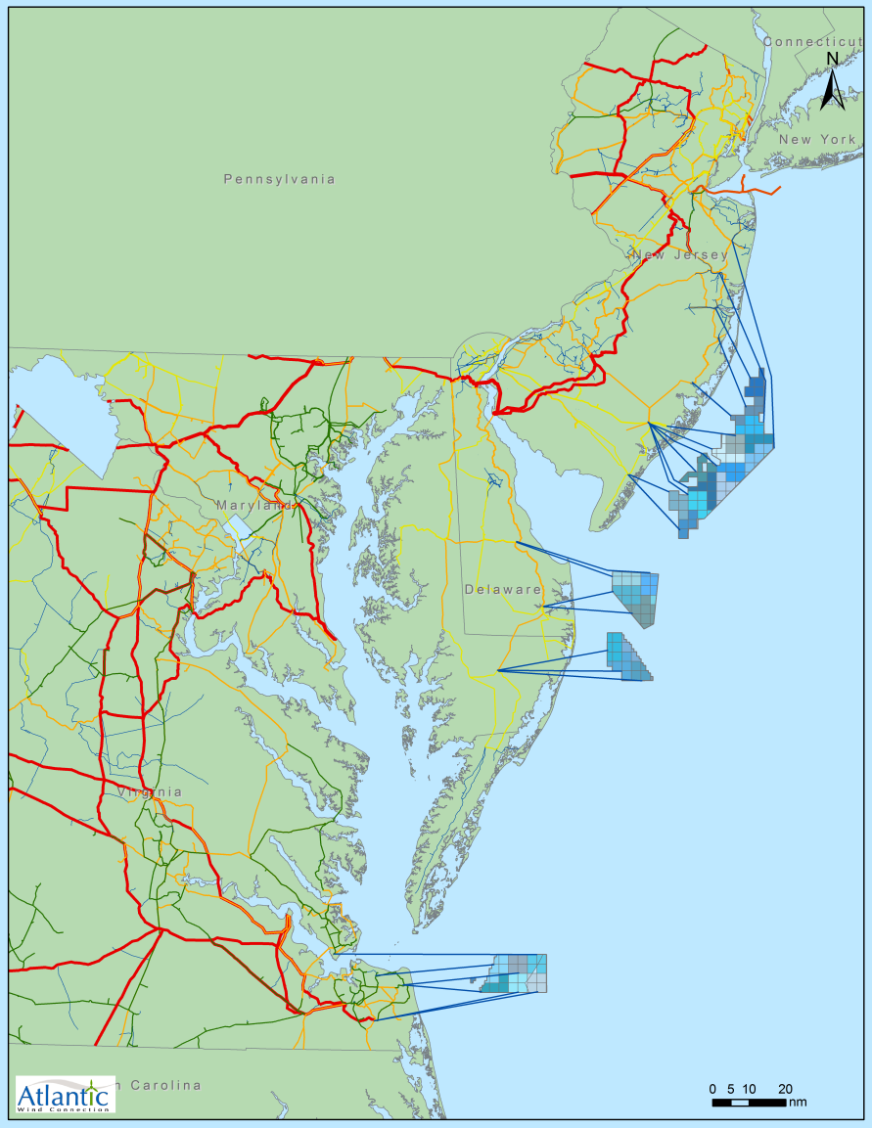
“Local roads or an interstate highway network?”
Planning ahead to avoid obstacles will save ratepayers money

Slide 5

“Local roads or an interstate highway network?”
Planning ahead to avoid obstacles will save ratepayers money in the long run
10 year plan to build 350 mile subsea HVDC transmission system off mid-Atlantic states in 5 phases
Enables up to 7,000 MW of offshore wind to be developed 12 or more miles off the coast
Helps make offshore wind affordable
Enables replacement of 5 coal plants – 16 million tons of CO2
Is buildable because it can be permitted
Makes the PJM grid more robust
$43 billion in benefits from transmission and offshore wind
Private venture

Slide 6
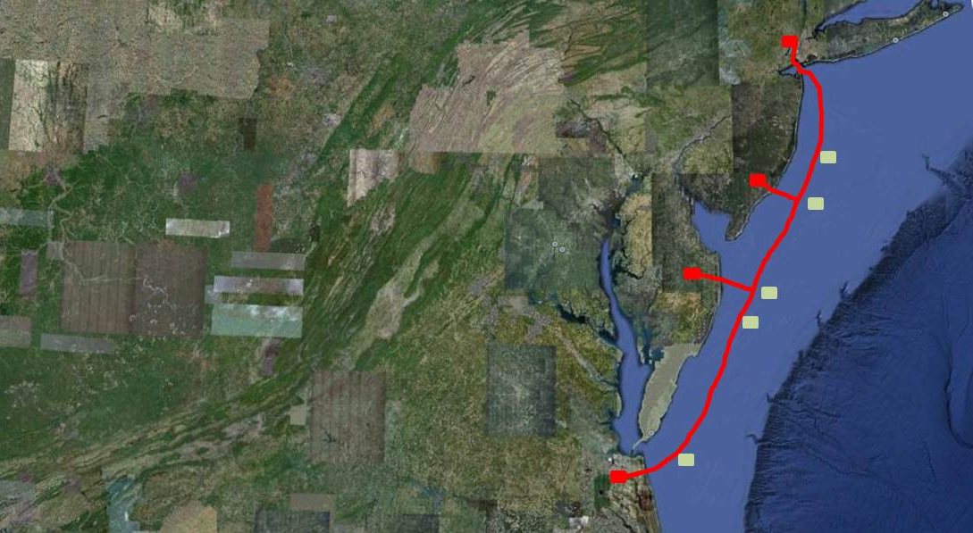
The Atlantic Wind Connection
Makes Offshore Wind…
  AWC offshore electric grid uniquely promotes large-scale offshore wind development – scale sufficient to make a positive environmental impact, create thousands of jobs, and reduce the cost of offshore wind.
Bigger
  AWC provides a platform on which offshore wind developers can interconnect their wind farms with significantly reduced siting, permitting and interconnection barriers, thus speeding the process of offshore wind development.
Faster
  AWC’s offshore electric grid will have a limited number of landfall points and thus, reduce disturbance to sensitive coastal environments.
Greener
  A 2010 Brattle Group study found that AWC will reduce the overall costs of developing nearly 7,000 MW of offshore wind farms by between $1.2 to $3 billion
Affordable

Slide 7





HVDC cable to other AWC converter stations
The AWC backbone is a better value for ratepayers
  Two transmission options to get offshore wind to load.
  Each wind farm lays 3 or more cables to get power to land (radial interconnections or “ties”), or
  The wind farms connect to a high-capacity offshore backbone.
  Either way, ratepayers will cover the cost.
  The question is which option is the best value and how to build and pay for it?
  The AWC backbone solution is cheaper than radial interconnections and provides greater benefits.
350 MW AC substation
1000 MW HVDC substation
AC substation
Buried HVDC cable
Overhead AC cable
Buried AC cable
HVDC cable to other AWC converter stations

Slide 8
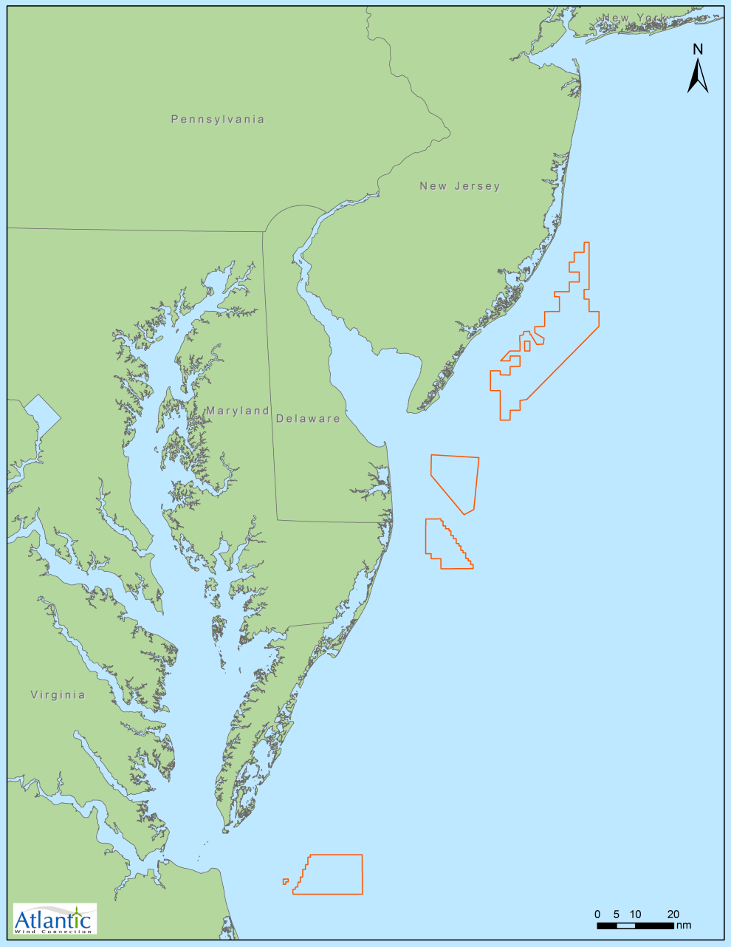
U.S. Department of Interior – “Smart from the Start”
Designated Wind Energy Areas

Slide 9
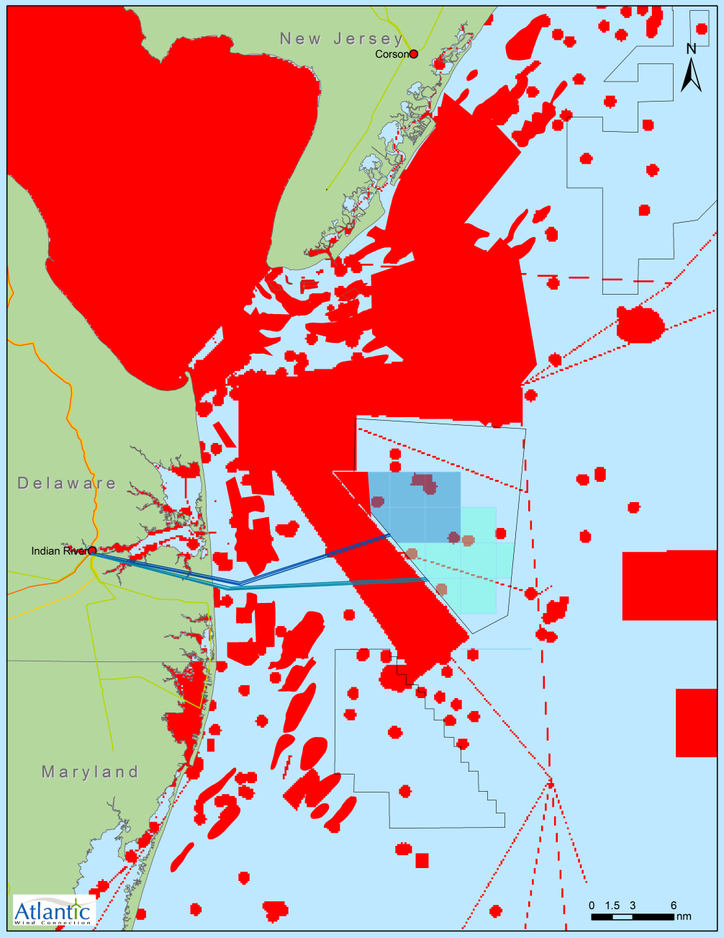
Technical limitations and practical siting constraints cause radial ties to be more expensive than AWC’s backbone
Delaware Example
 | Radials: AC technology | AWC: DC technology
Total capital cost | $505 million | $464 million
Savings with AWC |  | $41 million
The DC cables used by AWC are more efficient.
  1,000 MW of capacity can be delivered on just two of AWC’s DC cables.
  Delivering the same capacity with radial ties using AC cables takes five or more three-core 138 kV AC cables.
AC cables are bigger than DC cables and use more copper costing the ratepayers more.
Significant routing restrictions favor AWC.
Constraints in red include DOD & NASA restricted areas, shipping lanes, and sand & gravel areas. Longer cable routes to avoid constraints increase cost.

Slide 10
Less environmental disruption with AWC.
Fewer permitting hurdles for wind developers.
Delaware Example
With AWC there will be many fewer cable crossings of sensitive areas and less disturbance to communities. Most AWC cables will be underground.
AWC allows wind farm developers to avoid all state and local permitting, except Coastal Zone Program consistency determination.
  Greater predictability and lower risk leads to a lower cost of capital and a lower cost of energy for ratepayers.
  AWC allows for faster wind development and in-service dates and lower overall wind cost for ratepayers
Typical wind farm developer state permitting obstacles
Using radial interconnections | Using an AWC backbone interconnection
Coastal Zone Consistency Determination Coastal Zone Permit Coastal Construction Permit for Construction Seaward of the DNREC Building Line Construction Letter of Approval Wetlands and Subaqueous Lands Permit NPDES Construction Permit Consultation with SHPO/THPO Delaware DOT Utility Construction Permit | 1. Coastal Zone Consistency

Slide 11
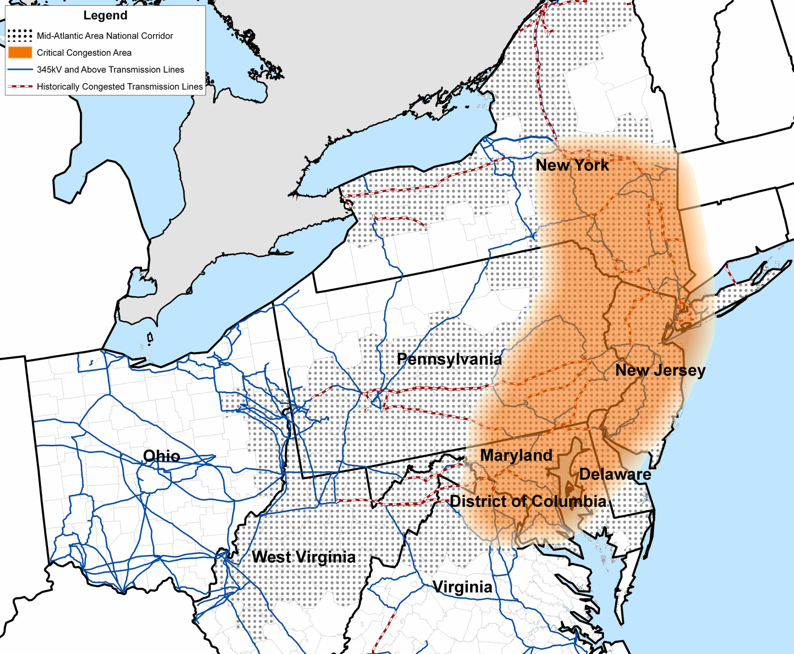
AWC lowers the hidden costs consumers pay for congestion.
Congestion is the inability to deliver power where it is needed.
Eliminating congestion would provide huge value to consumers.
Additional land-based transmission is not the best way to relieve congestion. It is difficult and expensive to implement, and vulnerable to typical failures.
An offshore backbone is more easily built, electrically separate, and more secure.

Slide 12
A Concern on the Horizon: PJM is planning new Midwest and east coast transmission facilities that will be able to move large amounts of Midwest wind to the east coast.
Delaware and other east coast states will pay for these additions.
  Just the Midwest additions will cost Delaware about $16 million per year (more if new eastern transmission also is built).
Delaware’s RPS and transmission rates will promote Midwest wind jobs and economic development, not Delaware jobs.
Delaware will get less in reliability and congestion relief benefits with Midwest transmission than with the AWC offshore backbone.
  Wind dispatched along the coast lowers prices in the east more than wind dispatched in the Midwest.
PJM TEAC (August 4, 2011)
Approx. $5 billion of proposed Midwest transmission to support RPS requirements.

Slide 13
Regional Offshore Wind Industry Potential Benefits
Total benefits from 6,600 MW of offshore wind plus AWC are substantial
Capital cost approx. $28 billion ($4,200/kW): Benefits approx. $44 billion
Benefit | Estimated net present value | Notes
Offshore wind energy value | $12 billion | Value of offshore wind energy generated by 6,600 MW) of wind farms.
Energy market price suppression | $17 billion | Wind energy bids into the auction based energy markets at zero and reduces energy market clearing prices.
AWC production cost savings and capacity market savings | $3.4 billion | AWC provides production cost savings by promoting more efficient dispatch of generation. AWC provides a controllable transmission network that has significant capacity value.
Reliability improvements | $2 billion | AWC improves voltage and frequency regulation and can help re-start the grid after a blackout. This estimate is a fraction of the estimated cost of the 2003 northeast blackout ($7-$10 billion).
Tax benefit from job creation and economic activity | $4 billion | The Brattle Group estimated economic activity at $30-$52 billion and job creation at 183,000 – 263,000 FTE job-years for 6,600 MW of offshore wind and the AWC backbone. We estimate associated tax revenues at a small fraction of this economic activity $4 billion.
Value of emission reductions | $5.2 billion | Offshore wind produces significant reductions in CO2, SO2 and NOx. Assuming $30/ton, the value of reduced CO2 emissions alone is equal to $5.2 billion.

Slide 14




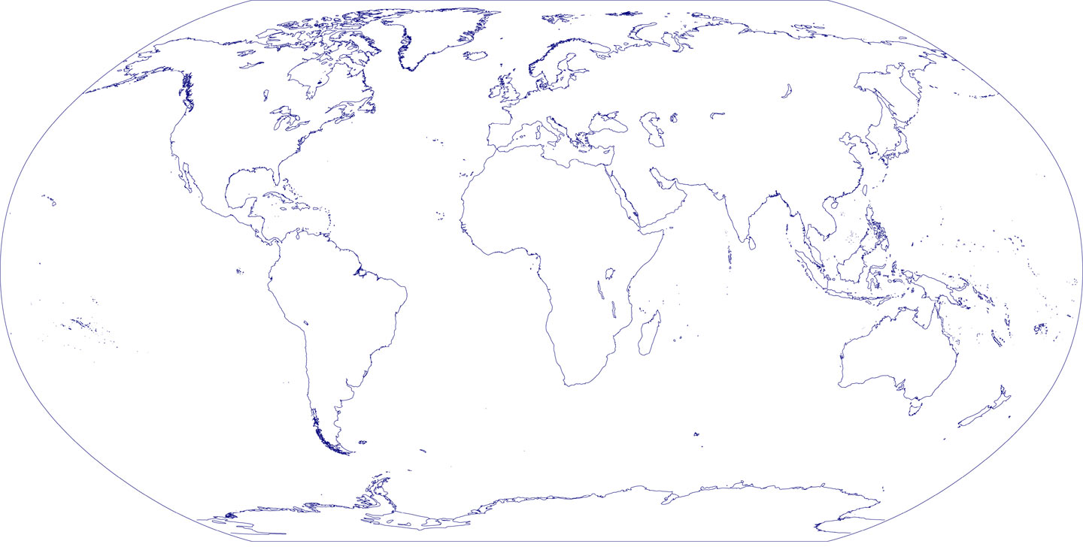

AWC is funded by a team of global investors
Development Led by Experienced Independent Transmission Company

Slide 15
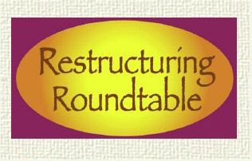

This presentation was given at the 12.9.2011
New England Electricity Restructuring Roundtable,
“Renewable Energy-Related Transmission for New Englanders: by Land and by Sea” convened and moderated by Raab Associates, Ltd.

